Slide 1
COMP-4990 Vision-based Obstacle Detection
Joshua Gehl Austin Formagin Jarrett Jackson Brady Malott
Supervisor: Dr. Boufama

Slide 2
Objective
Vision-based obstacle detection for objects in a straight path using two images
Identify key points in two images using the SIFT (Scale Invariant Feature Transform) algorithm [1]
Pair up the key points using FLANN (Fast Library for Approximate Nearest Neighbors) library [2]
Use RANSAC (Random Sample Consensus) algorithm [3] to compute a homographic matrix, which maps points from the first image to the second image
Use the homographic matrix to map points from the first image to the second image and determine the existence of an object

Slide 3
Project Requirements
Determine the presence of objects on a path by inputting two images
Implemented using OpenCV and python
Must use the RANSAC algorithm to compute a homographic matrix
Intuitive user interface to input images and display the detected objects

Slide 4
Key Point Detection & Feature Matching
Images are converted to greyscale to reduce the number of channels, which reduces computation time
Used the SIFT feature detector over ORB due to SIFT’s greater accuracy at detecting key points
Used the FLANN-based matcher to generate a list of possible matched key points between the images. FLANN returns the two best matches for each point in the first image
Removed ambiguous matches using the Lowe's Ratio Test
If the distance between the two best matches is not sufficiently different, the match is removed.
The result is a list of key points that are matched between the two inputted images.

Slide 5
SIFT (Scale-Invariant Feature Transform)
Created by D.Lowe in 2004 at UBC
Detects features within an image regardless of scale or orientation
Four main steps:
Scale-space extrema detection – Uses difference of gaussian on the scale-space and finds local extrema amongst neighbouring pixels
Key point localization – Uses Taylor series expansion of scale space and Harris corner detection to eliminate low contrast and edge key points
Orientation assignment – An orientation histogram with 36 bins is created from neighbours around a key point. Any peaks above 80% are considered to calculate the orientation.
Key point descriptor – 16x16 neighbourhood around the key point is divided into 16 sub blocks, each with an 8-bin orientation histogram, represented as a vector.
[4] D. G. Lowe, “Distinctive Image Features from Scale-Invariant Keypoints,” International Journal of Computer Vision, vol. 60, no. 2, pp. 91–110, Nov. 2004, doi: https://doi.org/10.1023/b:visi.0000029664.99615.94.

Slide 6
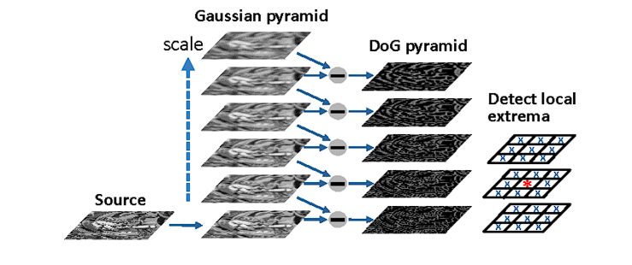
SIFT (Con’t)
Figure 1: Scale-space extrema detection Uses difference of gaussian on the scale-space and finds local extrema amongst neighbouring pixels
[5] G. Wang, B. Rister and J. R. Cavallaro, "Workload analysis and efficient OpenCL-based implementation of SIFT algorithm on a smartphone," 2013 IEEE Global Conference on Signal and Information Processing, Austin, TX, USA, 2013, pp. 759-762, doi: 10.1109/GlobalSIP.2013.6737002.

Slide 7
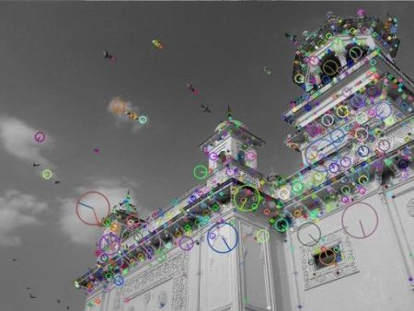
SIFT (Con’t)
Figure 2: Key points drawn with orientation
[1] “OpenCV: Introduction to SIFT (Scale-Invariant Feature Transform),” Opencv.org, 2020. https://docs.opencv.org/4.x/da/df5/tutorial_py_sift_intro.html

Slide 8
Feature Matching
The two types of feature matchers that were considered include:
FLANN (Fast Library for Approximate Nearest Neighbors)
Contains a collection of algorithms that work best for nearest neighbor searches in high-dimensional spaces ‌[2]
Brute Force
Matches features using distance measurements such as:
Euclidian Distance: L1, L2, L2SQR
Hamming Distance

Slide 9
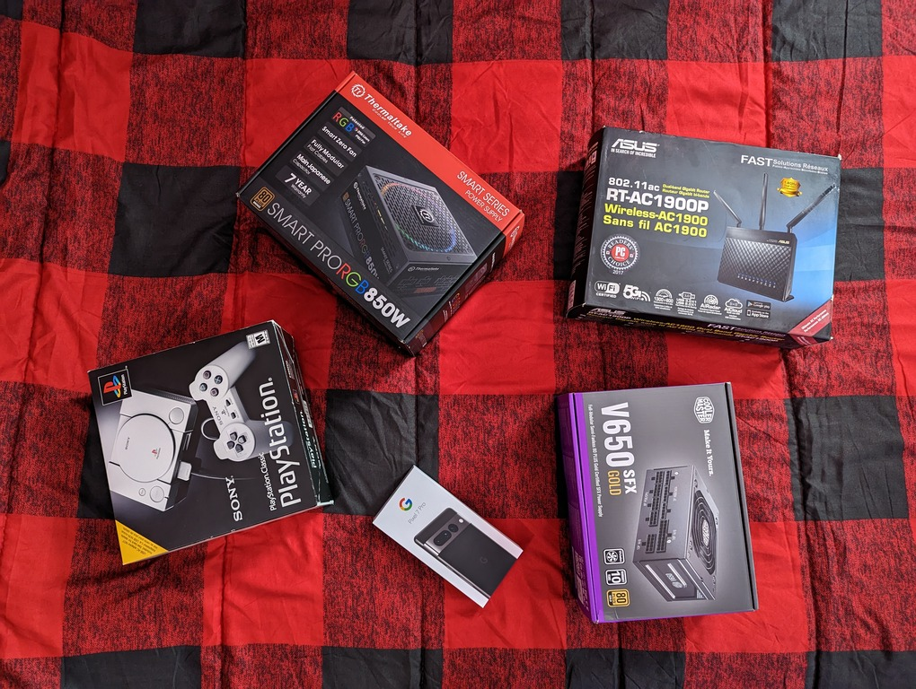

Key Point Detection & Feature Matching (Con’t)
Figure 3: Two images used to test, which were scaled down to test different resolutions

Slide 10
Key Point Detection & Feature Matching (Con’t)
Images |  | SIFT/FLANN |  | ORB/Brute Force
Image 1 Resolution | Image 2 Resolution | Execution Time (s) | Key Point Matches Found | Execution Time (s) | Key Point Matches Found
3852x3000 | 4080x3072 | 8.983 | 1485 | 0.541 | 160
1926x1500 | 2040x1536 | 1.477 | 912 | 0.269 | 140
963x750 | 1020x768 | 0.383 | 196 | 0.199 | 122
385x300 | 408x307 | 0.064 | 16 | 0.173 | 114
Figure 4: Execution time and number of matches found for SIFT/FLANN and ORB/Brute Force

Slide 11
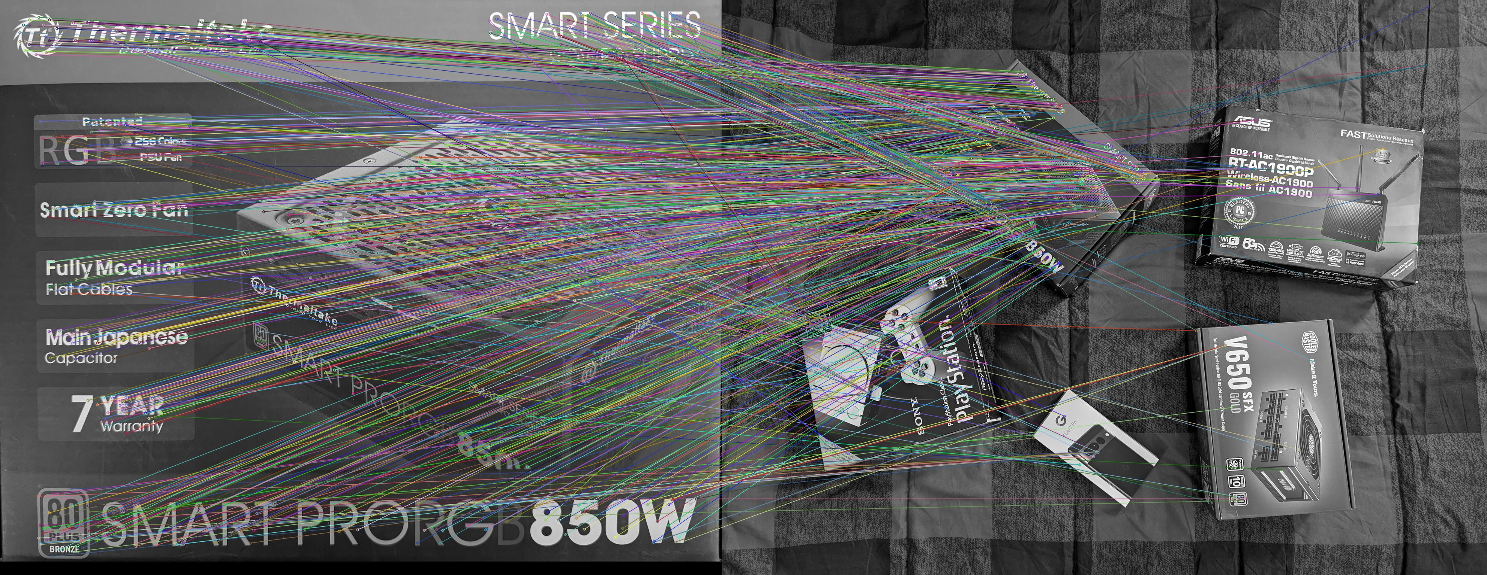
Key Point Detection & Feature Matching (Con’t)
Figure 5: Results of SIFT key point detection and FLANN-based matching on the 50% size images

Slide 12
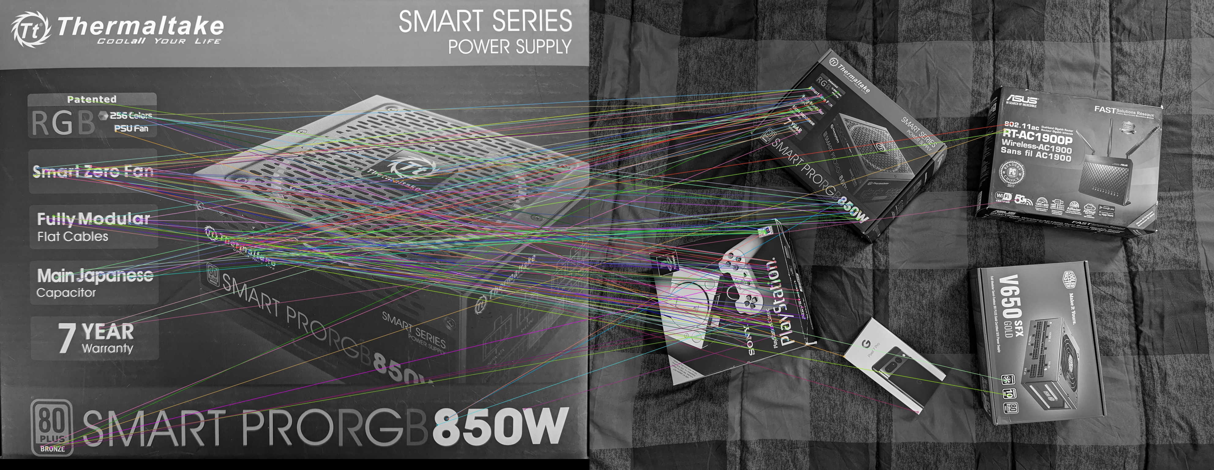
Key Point Detection & Feature Matching (Con’t)
Figure 6: Results of ORB key point matching and Brute Force – based matching on the 25% size images.

Slide 13
RANSAC Algorithm
Using the matched points, we compute a homographic matrix using the RANSAC algorithm and OpenCV’s cv2.findHomography() function
RANSAC repeats an iterative process to compute a model with as many inlier points and as few outlier points as it can
The homographic matrix is a 3x3 matrix which represents the projective transformation from the first image to the second image

Slide 14
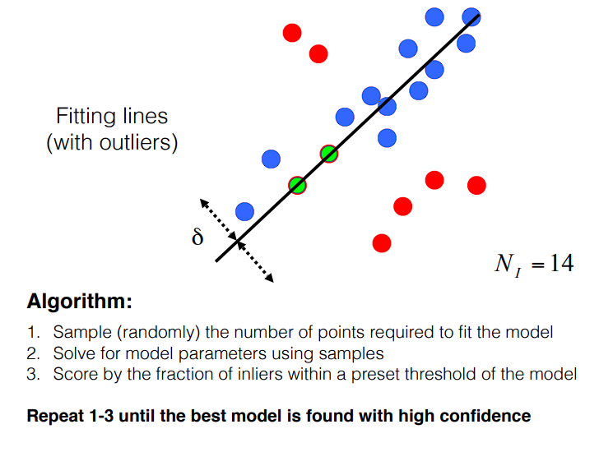
RANSAC Algorithm (Con’t)
Figure 7: Pseudocode for RANSAC algorithm with diagram
[6] K. Kitani, “RANSAC 16-385 Computer Vision,” Carnegie Mellon University. https://www.cs.cmu.edu/~16385/s17/Slides/10.3_2D_Alignment__RANSAC.pdf, (Accessed Mar. 2023)

Slide 15
RANSAC Algorithm (Con’t)
Figure 8: SIFT / FLANN matched images before RANSAC outlier removal

Slide 16
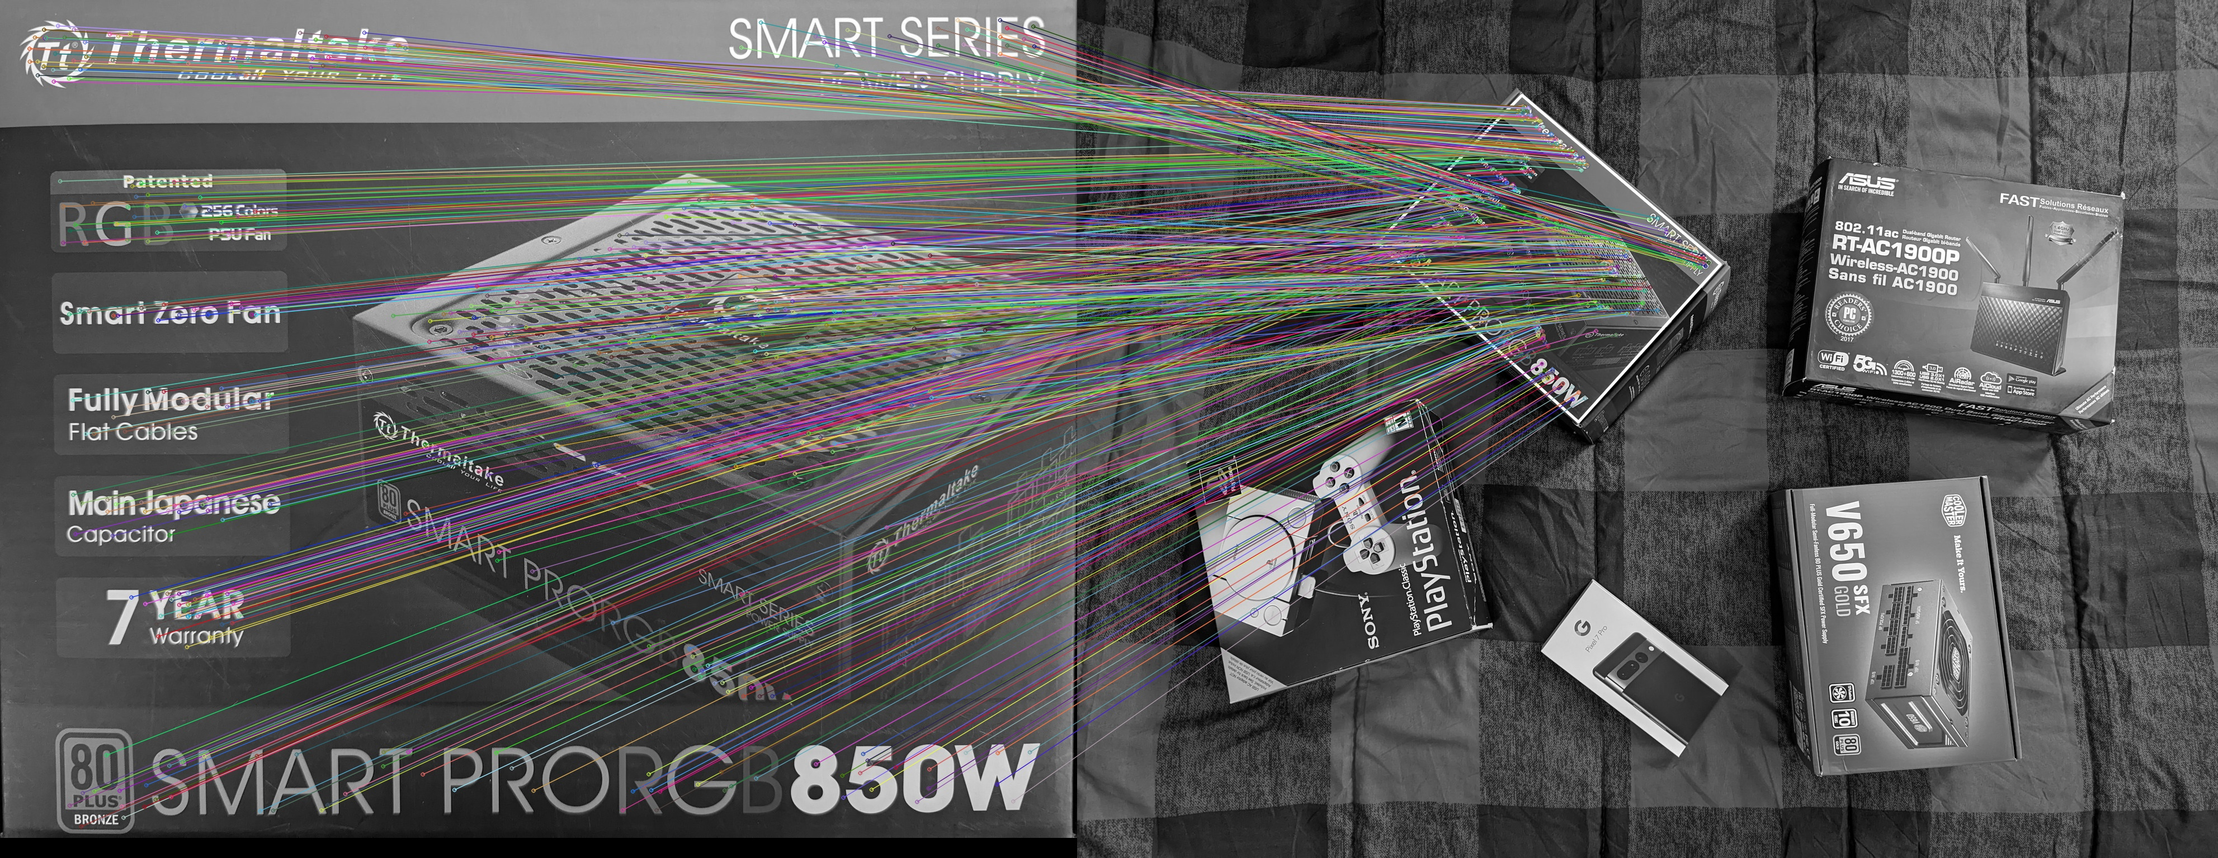
RANSAC Algorithm (Con’t)
Figure 9: Inlier matches computed by RANSAC algorithm

Slide 17
Simple UI + Web Server
Created a self-hosted flask web app to test the project
Users can upload two images and choose a minimum number of points
Then, clicking a button runs the algorithms and detects the objects in the path
The two images are displayed to show the matching of key points

Slide 18
Challenges & Achievements
Challenges:
Collaborating frequently was difficult because we all had very busy schedules throughout the year
SIFT algorithm was very computationally expensive, which limited our real time capabilities especially on large images
It was difficult to prevent our algorithm from detecting key points from details in the image other than the object itself
We had to rely on using a static mask to outline the path in our images rather than determining it based on the image
Achievements:
Successfully implemented the obstacle detection
Created an intuitive user interface to experiment with our work
Gained valuable knowledge on the SIFT and RANSAC algorithms and the process behind detecting and matching features between two images

Slide 19
Demonstration

Slide 20
Special Thanks
Thank you Dr. Boufama for his guidance throughout the project. He articulated his vision for the project very clearly and provided sufficient guidance as we developed the project
Thanks to all our team members for accomplishing all our main goals for this project, despite the busyness of our school year

Slide 21
Any Questions?

Slide 22
References
[1] “OpenCV: Introduction to SIFT (Scale-Invariant Feature Transform),” Opencv.org, 2020. https://docs.opencv.org/4.x/da/df5/tutorial_py_sift_intro.html
‌[2] “OpenCV: Feature Matching with FLANN,” Opencv.org, 2021. https://docs.opencv.org/3.4/d5/d6f/tutorial_feature_flann_matcher.html
[3] K. G. Derpanis, “Overview of the RANSAC Algorithm,” 2010. http://www.cse.yorku.ca/~kosta/CompVis_Notes/ransac.pdf
[4] D. G. Lowe, “Distinctive Image Features from Scale-Invariant Keypoints,” International Journal of Computer Vision, vol. 60, no. 2, pp. 91–110, Nov. 2004, doi: https://doi.org/10.1023/b:visi.0000029664.99615.94.
[5] G. Wang, B. Rister and J. R. Cavallaro, "Workload analysis and efficient OpenCL-based implementation of SIFT algorithm on a smartphone," 2013 IEEE Global Conference on Signal and Information Processing, Austin, TX, USA, 2013, pp. 759-762, doi: 10.1109/GlobalSIP.2013.6737002.
[6] K. Kitani, “RANSAC 16-385 Computer Vision,” Carnegie Mellon University. https://www.cs.cmu.edu/~16385/s17/Slides/10.3_2D_Alignment__RANSAC.pdf, (Accessed Mar. 2023)

